Slide 1

The Travelling Comedian Problem
https://www.linkedin.com/pulse/applying-traveling-salesman-problem-business-russ-penlington/
EdinbR User Group
22 March 2024
Nevil Hopley
github.com/NevilHopley

Slide 2
What’s in this Talk
celebration of comedian Dave Gorman’s UK tours
gganimate and maps
Monte Carlo style simulations (i.e. brute force!)

Slide 3
What’s not in this Talk
100% elegant code
all the trial-and-errors using gganimate
efficient graph theory algorithms
Dave Gorman

Slide 4
Me
Using R since January 2017.
Senior Data Analyst at the Scottish Qualifications Authority.
Previous EdinbR talks on...
Breakdown Plots, Google Maps, Riverplots,
R markdown, Shiny, Visualising Educational Data, Acing a Technical Interview.

Slide 5

Phoenix from the Flames

Slide 6
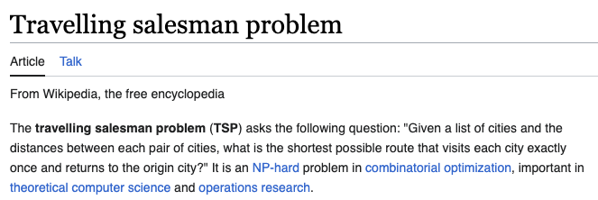
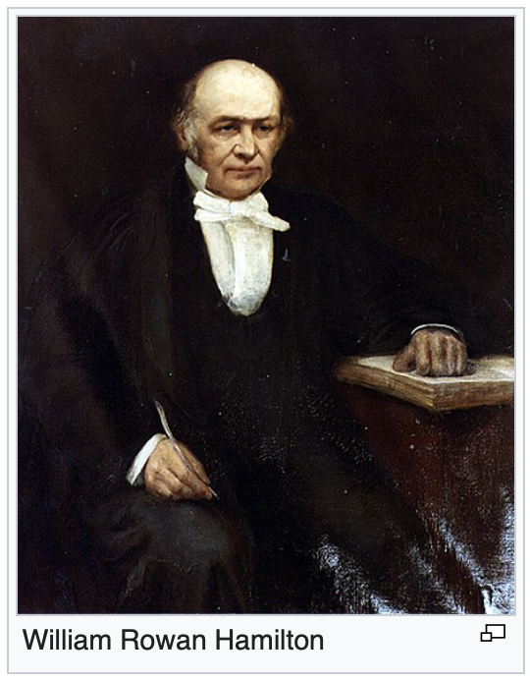
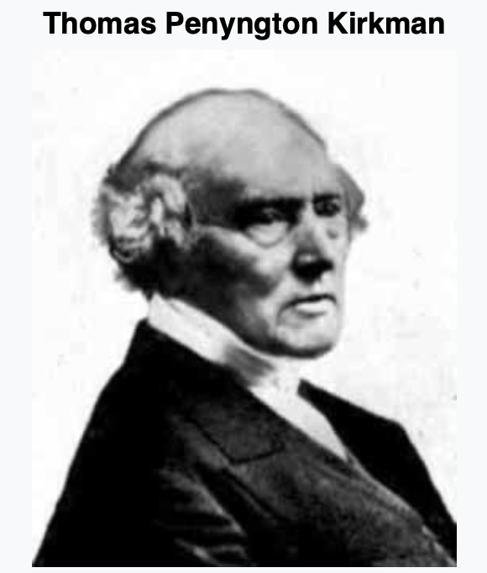
The Travelling Salesman Problem was mathematically formulated in the 19th century by the Irish mathematician William Rowan Hamilton and by the British mathematician Thomas Kirkman.

Slide 7
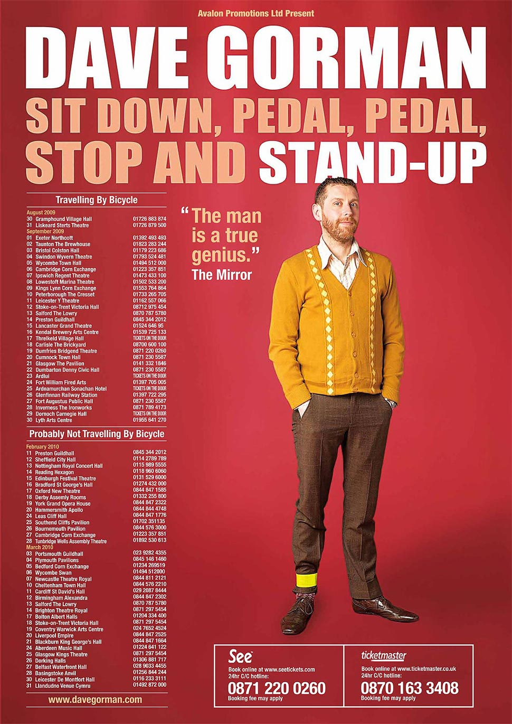

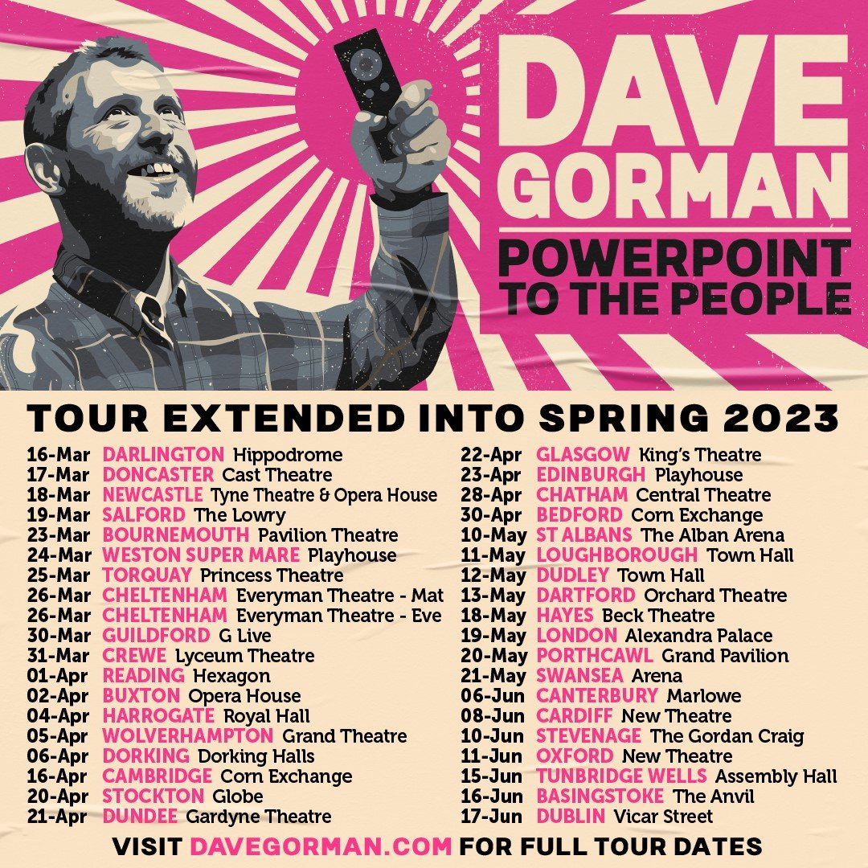

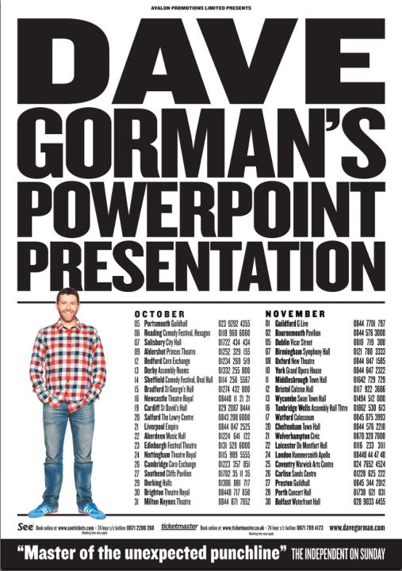

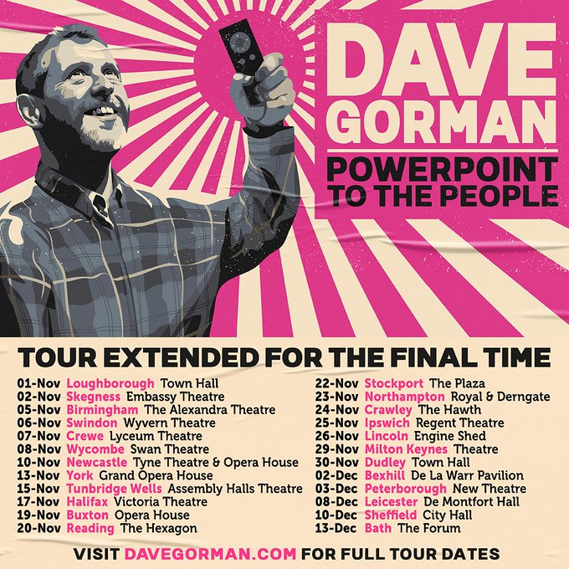
Travelling Comedian Problem

Slide 8

GitHub
https://github.com/NevilHopley/TravellingComedian

Slide 9
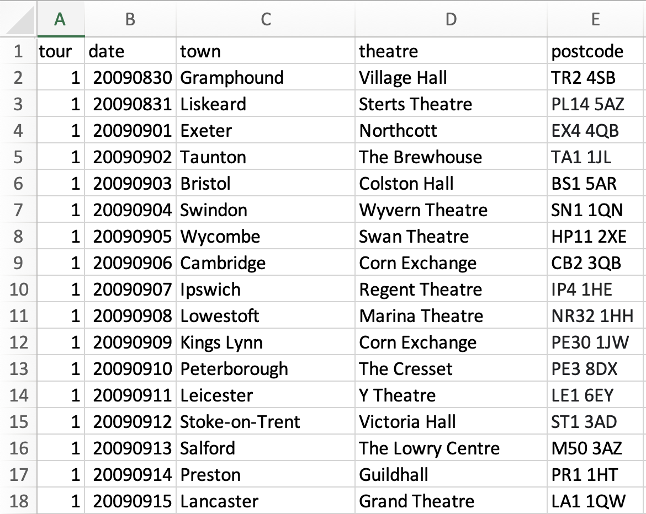

Curate Data

Slide 10
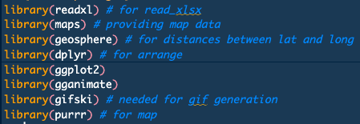
Packages

Slide 11
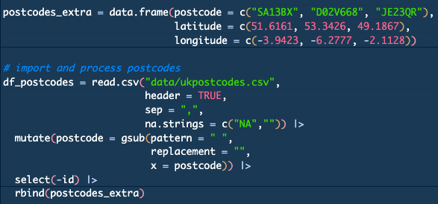
Load UK Postcodes

Slide 12
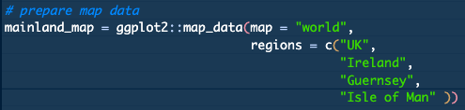
Load Maps

Slide 13
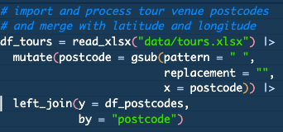
Load Tour Routes

Slide 14
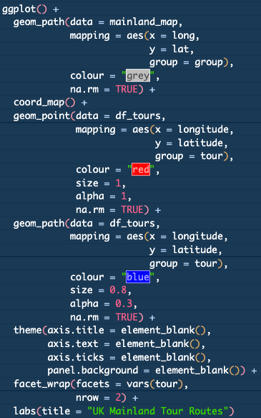
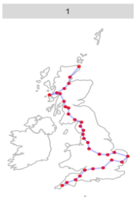
Static Maps

Slide 15
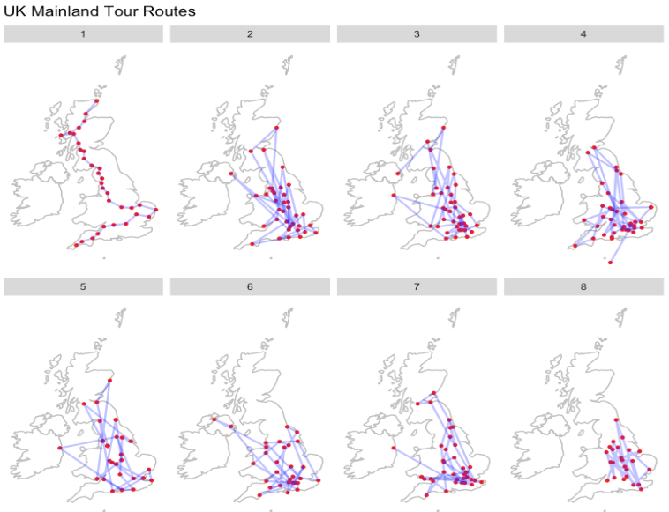
8 Tour Routes

Slide 16
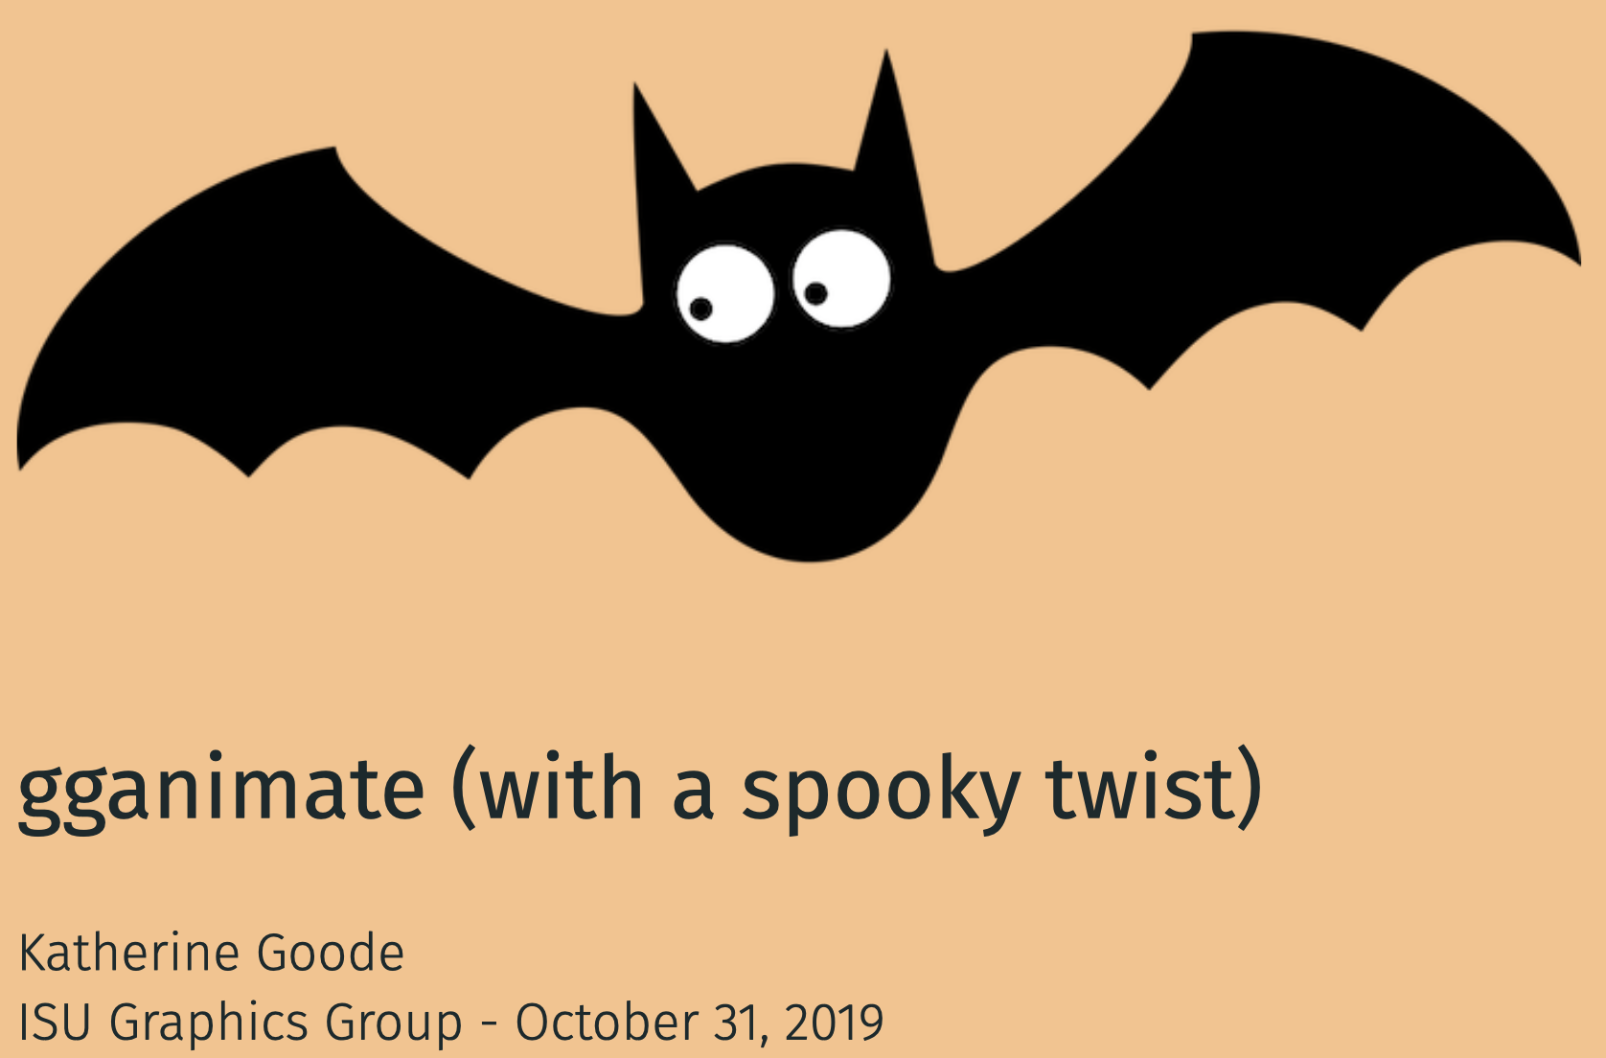
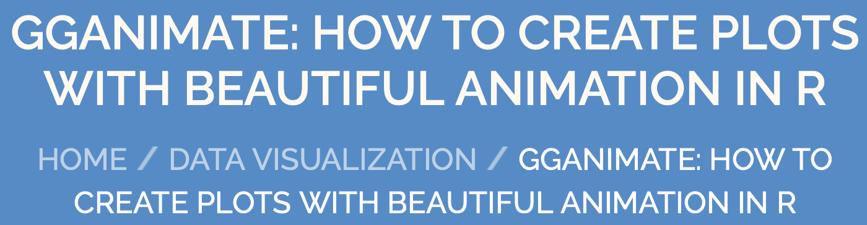
gganimate help
https://goodekat.github.io/presentations/2019-isugg-gganimate-spooky/slides.html#1
https://www.datanovia.com/en/blog/gganimate-how-to-create-plots-with-beautiful-animation-in-r/

Slide 17
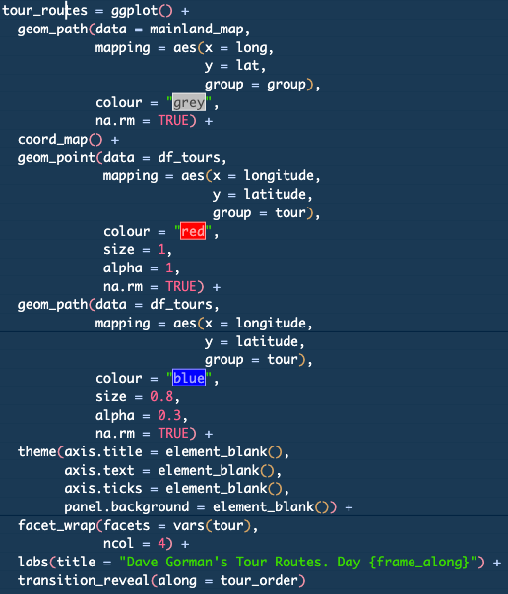
Animated Tour Maps
store ggplot to ‘tour_routes’
add in ‘transition_reveal(...)

Slide 18
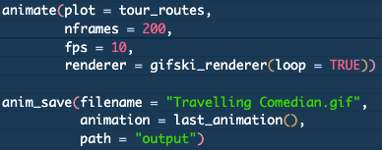
gganimate::animate
animate(...) takes a gganim object and renders it into an animation. The nature of the animation is dependent on the renderer, but defaults to using gifski to render it to a gif. The length and framerate is decided on render time and can be any two combination of nframes, fps, and duration.

Slide 19

Convert .gif to .mp4
https://www.freeconvert.com/convert/gif-to-mp4/

Slide 20
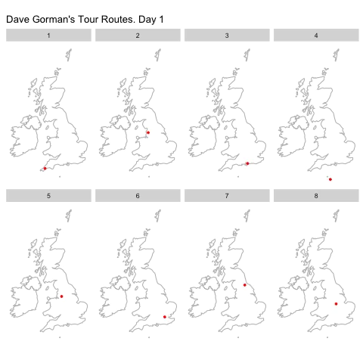
Animated Tour Maps

Slide 21
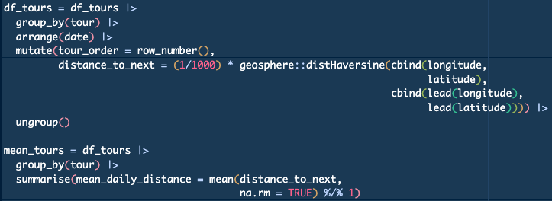
Mean Daily Distance Travelled

Slide 22
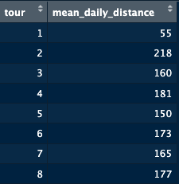
Mean Daily Distance Travelled
all distances in kilometres

Slide 23
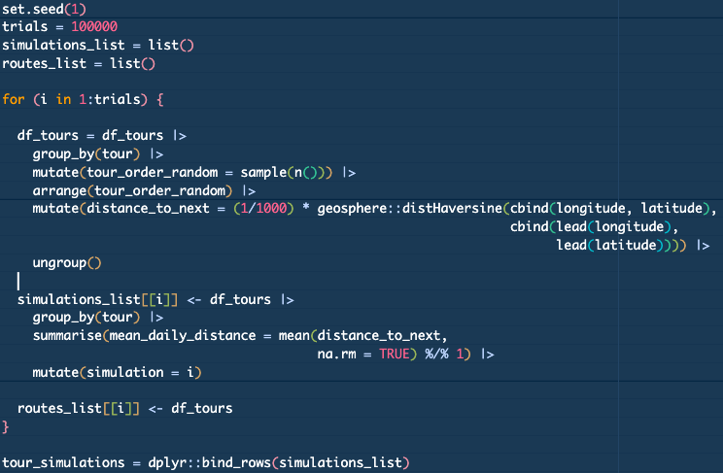

Monte Carlo Simulations

Slide 24
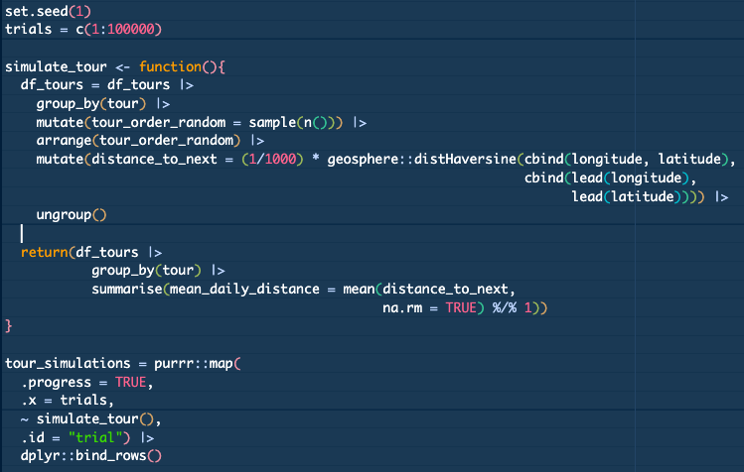

Monte Carlo Simulations

Slide 25
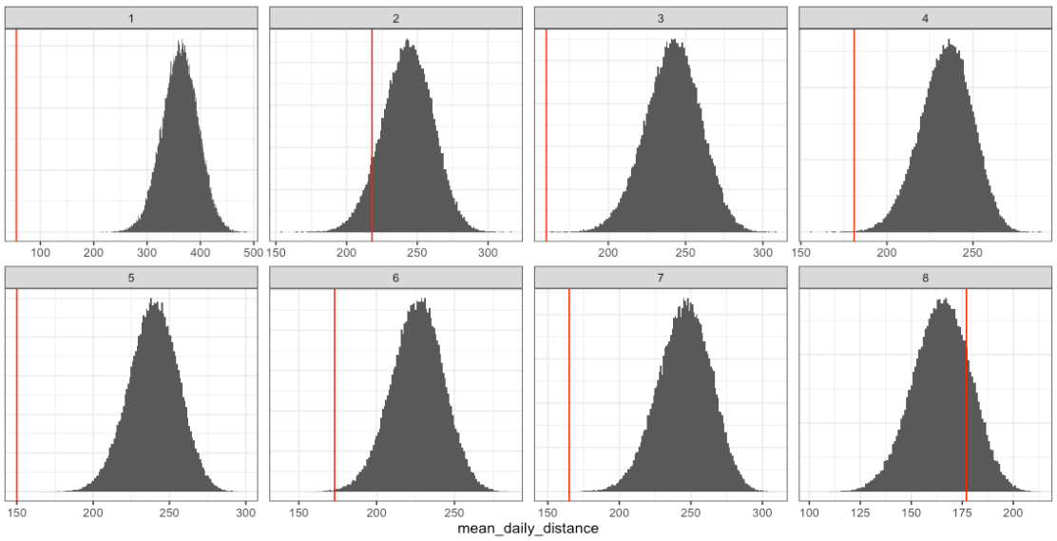
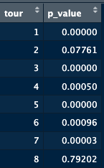
Simulation Results & p-values

Slide 26
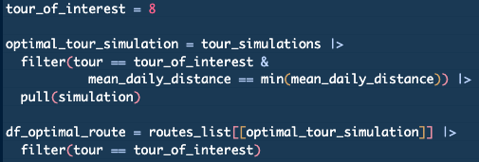
Optimal Route for Tour 8

Slide 27
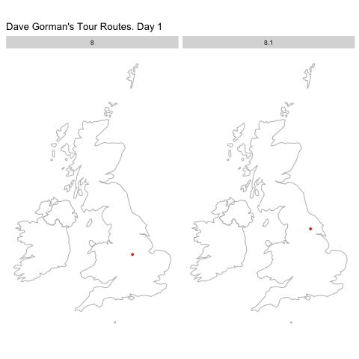
Optimal Route for Tour 8
Tour 8
mean daily distance
177km
Tour 8.1
mean daily distance
101km

Slide 28
Optimal Tour 8 Poster
Skegness Embassy Theatre
Leicester De Montfort Hall
Northampton Royal & Derngate Theatre
Crewe Lyceum Theatre
Stockport The Plaza
Lincoln Engine Shed
Peterborough New Theatre
Loughborough Town Hall
Newcastle Tyne Theatre & Opera House
York Grand Opera House
Halifax Victoria Theatre
Buxton Opera House
Dudley Town Hall
Birmingham The Alexandra Theatre
Ipswich Regent Theatre
Tunbridge Wells Assembly Hall Theatre
Crawley Hawth Theatre
Bexhill De La Warr Pavilion
Reading The Hexagon
Wycombe Swan Theatre
Bath The Forum
Milton Keynes Theatre
Sheffield City Hall
Swindon Wyvern Theatre

Slide 29

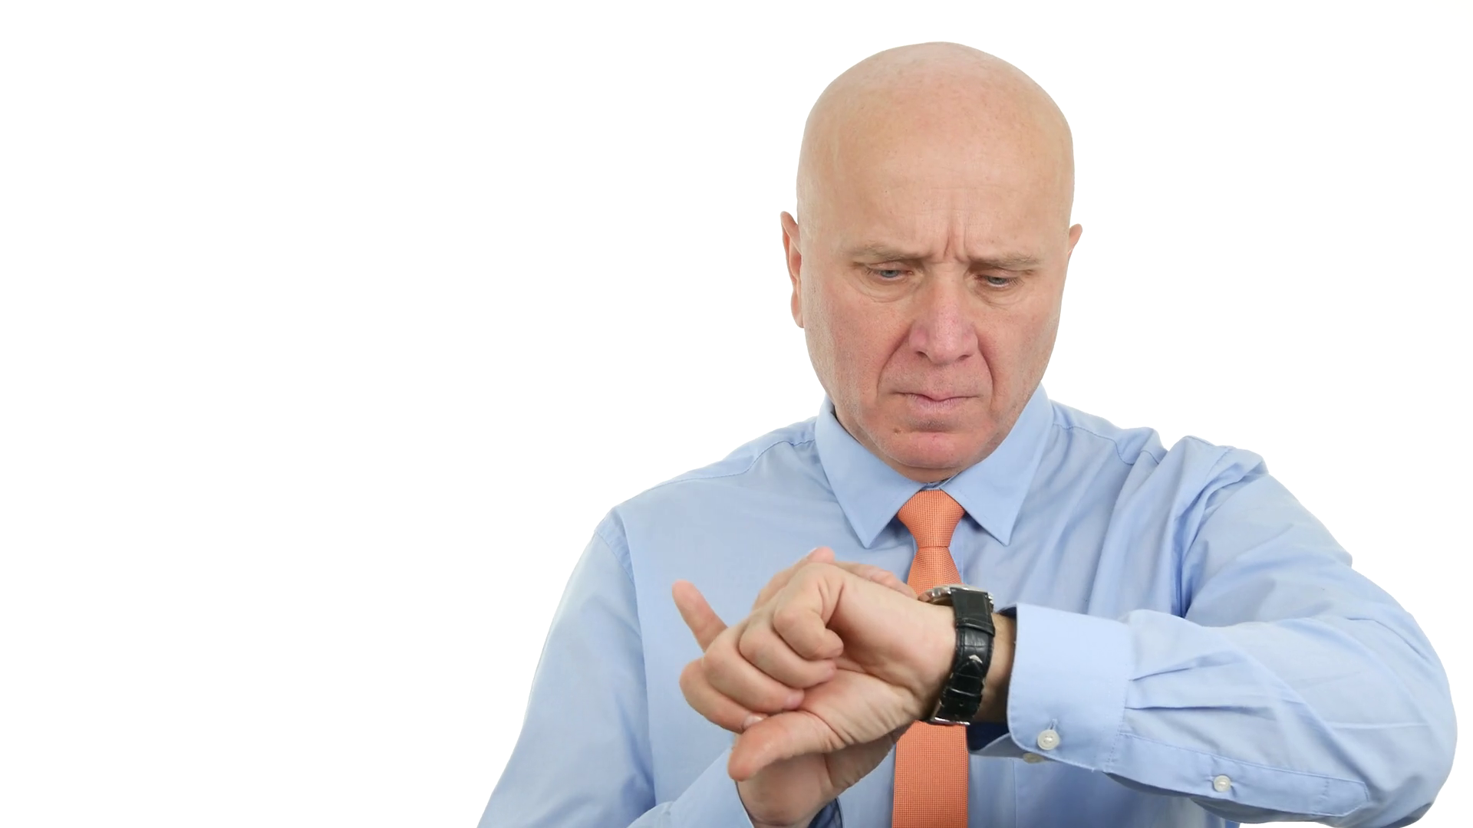

Do we have time for questions?
Edinburgh Group
Wed 25 Sep 2024
Could you help with a future event?
Scan the code below to
find out more and to sign up.
rsse.nhost.uk
https://www.videoblocks.com/video/business-person-waiting-a-late-meeting-looking-nervous-hand-watch-gesturing-brdeqsyl-j2sggsat

